Slide 1


Optimization3 of Stem Pairing
Week 10 Hua Jiang

Slide 2
Three main flaws of the algorithm:
Crossroad Problem
2. The Triangle Problem
3. The Problem of Skipping

Slide 3
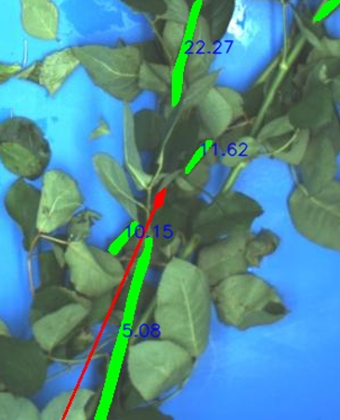
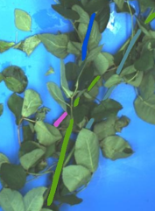
Crossroad Problem
When a stem is at the center of the crossroad, it will be the best candidate for all roads (other stems). Who it picks is deterministic.
Upper best candidate
Lower best candidate

Slide 4
Crossroad Problem
Solution:
Consistency Identification
- For a stem both paired with the best upper/lower candidate. Check the orientation of two paterners. The error shall not be larger 20 degree, otherwise remove the candidate with relative higher score.
Removed
Larger than 20 degree

Slide 5
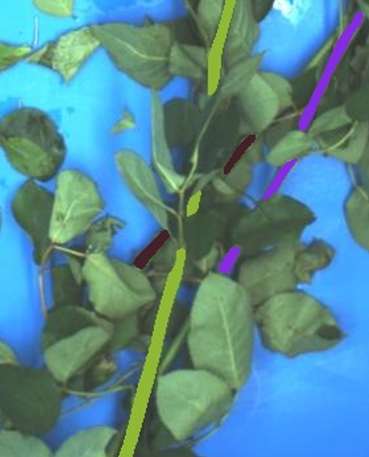
Crossroad Problem
Solution:
Consistency Identification
- For a stem both paired with the best upper/lower candidate. Check the orientation of two paterners. The error shall not be larger 20 degree, otherwise remove the candidate with relative higher score.

Slide 6
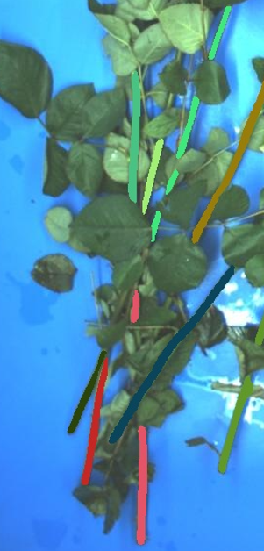
2. Triangle Problem
In the densely overlapping area，with poor mask segmentations, stems sometimes are not correctly paired.
Here is A->D->E->C->B->F->E
F
C
D
E
A
B

Slide 7
2. Triangle Problem
Solution:
Final Cluster Merge
- We put each final cluster as one long stem, counting score with PCA and pairing till nothing change
Stem B
Considered as Stem A

Slide 8

2. Triangle Problem
Solution:
Final Cluster Merge
- At the end of the algorithm, we put each final cluster as one long stem, counting score through PCA calculation and pairing till nothing change
Stem B
Considered as Stem A

Slide 9

3. The Problem of Skipping
The middle stem might be skipped by its up/lower partner if it is a rhombus with relative high score.
Skipped

Slide 10

3. The Problem of Skipping
The middle stem might be skipped by its up/lower partner if it is a rhombus with relative high score.
Base Stem
Real Partner
Best candidate

Slide 11
3. The Problem of Skipping
Solution:
Intermediate Check
- If stem i and j are paired and there exists a stem k in the middle choosing both i and j as best lower/upper candidate respectively, as long as score_ki and score_kj < 20, connect i, j, k together.
Base Stem
Middle stem
i
k
j
Best candidate

Slide 12

3. The Problem of Skipping
Solution:
Intermediate Check
- If stem i and j are paired and there exists a stem k in the middle choosing both i and j as best lower/upper candidate respectively, as long as score_ki and score_kj < 20, connect i, j, k together.

Slide 13
Future Work:
Optimization4

